Slide 1


Unified Functional Testing

Slide 2
Contents
What is QTP/UFT?
Why QTP is the best testing tool?
Why UFT why not selenium
Advantages of QTP Automation
QTP - Automated Testing Process.
UFT - Record and Playback
What is Object Repository?
Object Spy
Actions

Slide 3
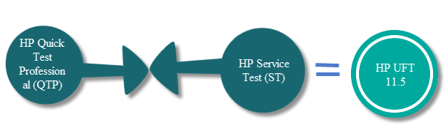
What is QTP/UFT?
HP QTP is an automated functional Testing tool that helps testers to perform automated regression testing
QTP stands for Quick Test Professional, a product of Hewlett Packard (HP)
Its first name was Astra Quick Test, later on called as Quick Test Professional and the latest version is known as Unified Functional Tester (UFT).
UFT is a mixture of HP QTP (GUI testing tool) and HP Service Test (API testing tool). Mixture of QTP and ST will be available on a single graphic user interface

Slide 4
Why QTP is the best testing tool?
It is an icon-based tool that automates the regression and Functional Testing of an application
It provides both features- Record as well as Playback
We can test Desktop as well as the Web-based applications
QTP Testing is based on scripting language VB script

Slide 5
Why UFT why not selenium
Selenium only web applications can be automated but UFT can test web- based as well as desktop applications
Selenium does not have such built in object repository but UFT comes with built in object repository.
HP UFT integrates with test management tool like HP Quality Center but there is no such tool that integrates with Selenium
It supports different environments like SAP, Oracle, .NET but user need to purchase add-on license for them but It supports addition of plug-ins to include features that are not provided by core Selenium

Slide 6
Advantages of QTP Automation
It uses an active screen to record scripts and helps tester in referring the screen object properties
It has excellent object identification process or mechanism
It supports popular automation frameworks- keyword driven testing approach, modular testing approach, data-driven testing approach, etc.
It comes with an inbuilt IDE
It supports XML

Slide 7
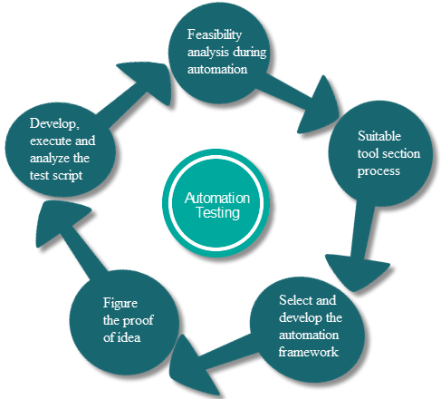
QTP - Automated Testing Process

Slide 8
UFT - Record and Playback
Record function records the user actions of the application to automatically generate the scripts that can be played back later
Different modes of Recordings
It is used as the preliminary investigation method to verify if UFT can support the technology/application.
Normal Recording
Analog Recording
Low-Level Recording
Insight Recording
It is used as the preliminary investigation method to verify if UFT can support the technology/application.

Slide 9
What is Object Repository?
Object Repository is a collection of object and properties with which QTP will be able to recognize the objects and act on it.
The stored object and together with its properties is called TEST Object
QTP stores Object and its properties in the Object Repository to identify them during run-time
There are two kinds of repositories:
Local
Shared

Slide 10
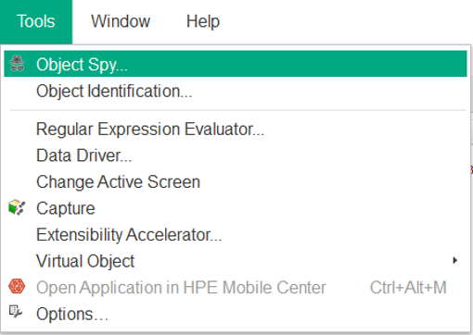
Object Spy
Object Spy is an extremely helpful tool that QTP has to view the properties and operations of an object in the AUT.

Slide 11
How QTP Identify Objects Uniquely?
TP has a predetermined set of properties that it learns/stores for every class of object it identifies.
Mandatory properties
Assistive properties
Ordinal Identifier
Smart Identification

Slide 12
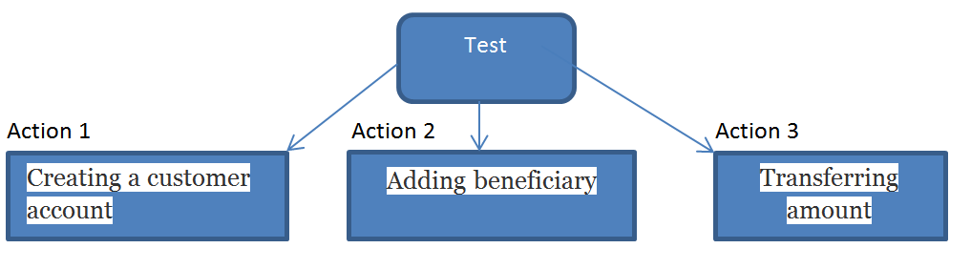
Actions
Actions help to divide the test into small parts and increase reusability

Slide 13
Types of actions
There are 3 types of calls to Actions.
Call to new Action
Call to copy of Action
Call to Existing Action
Types of Actions
Reusable
Non-reusable
External actions

Slide 14
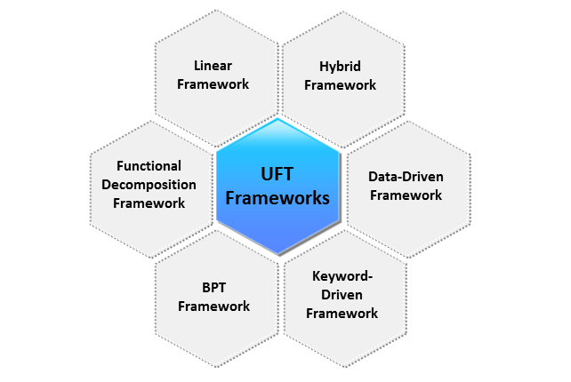
UFT frameworks

Slide 15
Checkpoints
A checkpoint is a verification point that compares the current value with the expected value for specified properties of an Object
Types of Checkpoints in UFT
Standard checkpoints
Page Checkpoint
Bitmap Checkpoint
Image Checkpoint
Text Checkpoint
Accessibility Checkpoints
Database Checkpoints
Table Checkpoint AND XML Checkpoints

Slide 16
What are the drawbacks of QTP?
Costly in terms of license and maintenance
Cannot run multiple threads/instances
Execution process is slow as compare to open source tools like Selenium
QTP license can only be renewed from HP only

